Slide 1
Discrete Structures
Lecture No. 3
Spring 2020
Course Instructor: Amna Irum
National University of Computer and Emerging Sciences, Islamabad

Slide 2
Biconditional
If p and q are statement variables, the biconditional of p and q is “p if, and only if, q” and is denoted p↔q.
if and only if abbreviated iff.
The double headed arrow " ↔" is the biconditional operator.

Slide 3
TRUTH TABLE FOR p↔q.
p | q | p ↔q
T | T | T
T | F | F
F | T | F
F | F | T

Slide 4
EXAMPLES
True or false?
1. “1+1 = 3 if and only if earth is flat”
TRUE
2. “Sky is blue iff 1 = 0”
FALSE
3. “Milk is white iff birds lay eggs”
TRUE
4. “33 is divisible by 4 if and only if horse has four legs”
FALSE
5. “x > 5 iff x2 > 25”
FALSE

Slide 5
p↔q ≡ (p→q)∧(q→p)
p | q | p↔q | p→q | q→p | (p→q)∧(q→p)
T | T | T | T | T | T
T | F | F | F | T | F
F | T | F | T | F | F
F | F | T | T | T | T

Slide 6
REPHRASING BICONDITIONAL
p↔q is also expressed as:
  “p is necessary and sufficient for q”
  “if p then q, and conversely”
  “p is equivalent to q”

Slide 7
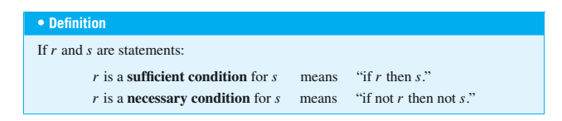
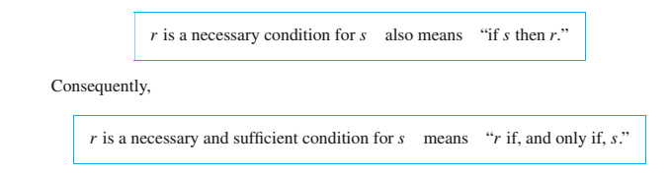

Slide 8
Exercise
Rephrase the following propositions in the form “p if and only if q” in English.
1. If it is hot outside you buy an ice cream cone, and if you buy an ice cream
cone it is hot outside.
Sol You buy an ice cream cone if and only if it is hot outside.
2. For you to win the contest it is necessary and sufficient that you have the
only winning ticket.
Sol You win the contest if and only if you hold the only winning ticket.
3. If you read the news paper every day, you will be informed and conversely.
Sol You will be informed if and only if you read the news paper every day.
4.It rains if it is a weekend day, and it is a weekend day if it rains.
Sol It rains if and only if it is a weekend day.
5. The train runs late on exactly those days when I take it.
Sol The train runs late if and only if it is a day I take the train.

Slide 9
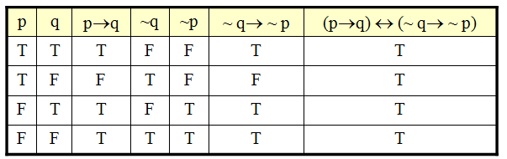
(p→q) ↔ (~ q→ ~ p)

Slide 10
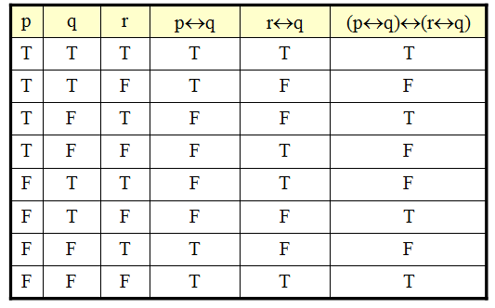
(p↔q)↔(r↔q)

Slide 11
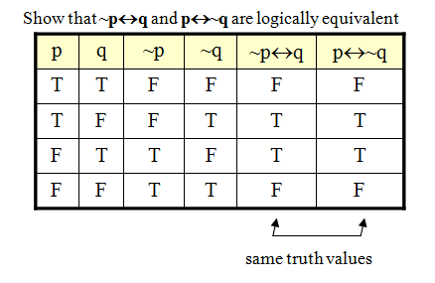
LOGICAL EQUIVALENCE INVOLVING BICONDITIONAL

Slide 12
LAWS OF LOGIC
:
1. Commutative Law: p ↔ q ≡ q ↔ p
2. Implication Laws:
p →q ≡ ~p ∨ q≡ ~(p ∧ ~q)
3. Exportation Law:
(p ∧ q)→r ≡ p →(q →r)
4. Equivalence:
p ↔ q ≡ (p →q)∧(q →p)

Slide 13
Rewrite the statement forms without using the symbols → or ↔
1. p∧~q→r
≡ (p∧~q)→r order of operations
≡~(p∧~q) ∨ r implication law

Slide 14
2. (p→r)↔(q →r)
≡ (~p ∨ r)↔(~q ∨ r) implication law
≡ [(~p ∨ r) →(~q ∨ r)] ∧ [(~q ∨ r) →(~p ∨ r)]
equivalence of biconditional
≡ [~(~p ∨ r) ∨ (~q ∨ r)] ∧ [~(~q ∨ r) ∨ (~p ∨ r) implication law

Slide 15
Argument
An interesting teacher keeps me awake. I stay awake in Discrete Mathematics class. Therefore, my Discrete Mathematics teacher is interesting.
Is the above argument valid?

Slide 16
Argument
An argument is a list of statements called premises (or assumptions or
hypotheses) followed by a statement called the conclusion.
P1 Premise
P2 Premise
P3 Premise
. . . . .. . . . .
Pn Premise
_____________
∴C Conclusion

Slide 17
Valid and Invalid Arguments
An argument is valid if the conclusion is true when all the premises are true.
Alternatively, an argument is valid if conjunction of its premises imply conclusion. That is (P1∧ P2 ∧ P3 ∧ . . . ∧ Pn) → C is a tautology.
An argument is invalid if the conclusion is false when all the premises are true.
Alternatively, an argument is invalid if conjunction of its premises does not imply conclusion.

Slide 18
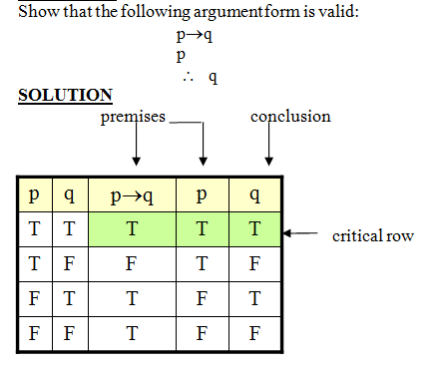
Example

Slide 19
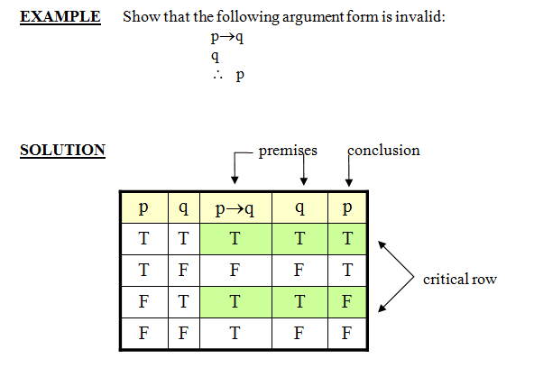
Example

Slide 20
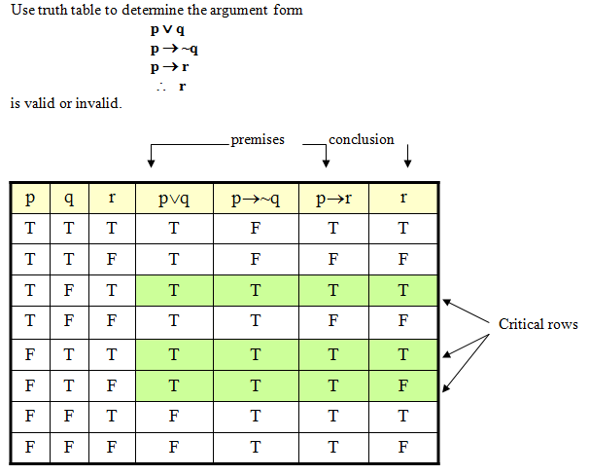

Slide 21
Word Problem
If Tariq is not in team A, then Hameed is in team B.
If Hameed is not in team B, then Tariq is in team A.
    Therefore
    Tariq is not in team A or Hameed is not in team B.

Slide 22
Solution
Let
t = Tariq is in team A
h = Hameed is in team B
Then the argument is
~ t → h
~ h → t
∴ ~ t ∨ ~ h

Slide 23
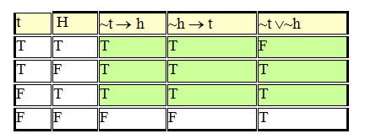
Solution (continued)

Slide 24
Syllogism
An argument form consisting of two premises and a conclusion is called a syllogism.
The first and second premises are called the major premise and minor premise, respectively.

Slide 25
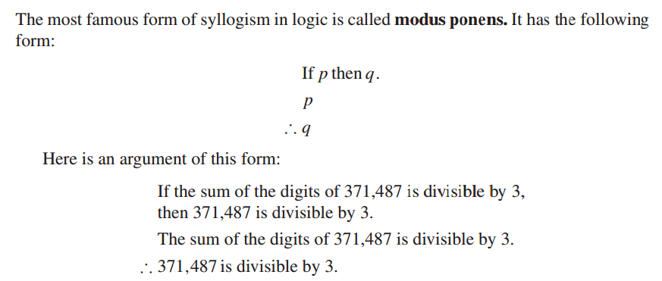
Modus Ponens

Slide 26
Modus Tollens
Another valid argument form called modus tollens.
An intuitive explanation for the validity of modus tollens uses proof by contradiction.
It has the following form:
  If p then q.
  ∼q
  ∴∼p
Example
If the watch-dog detects an intruder, the dog will bark. The dog did not bark. Therefore, no intruder was detected by the watch-dog.

Slide 27
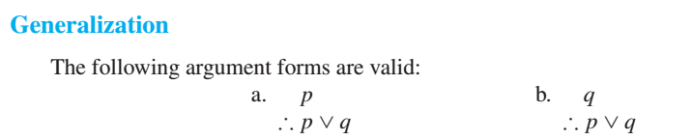
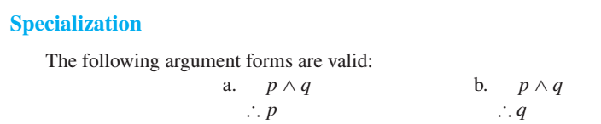
Additional Valid Argument Forms: Rules of Inference

Slide 28
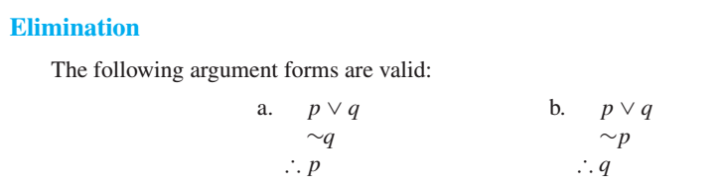
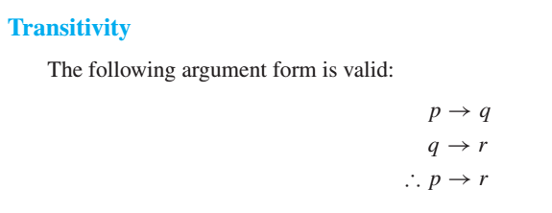

Slide 29
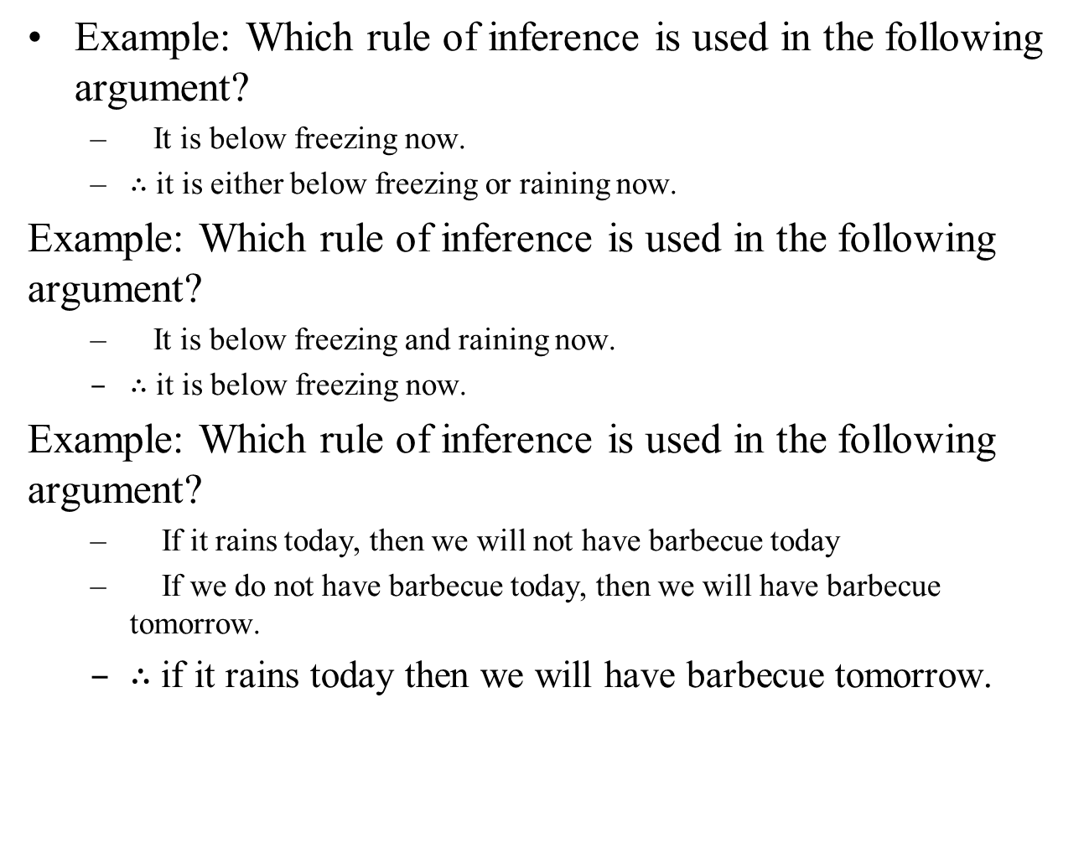

Slide 30
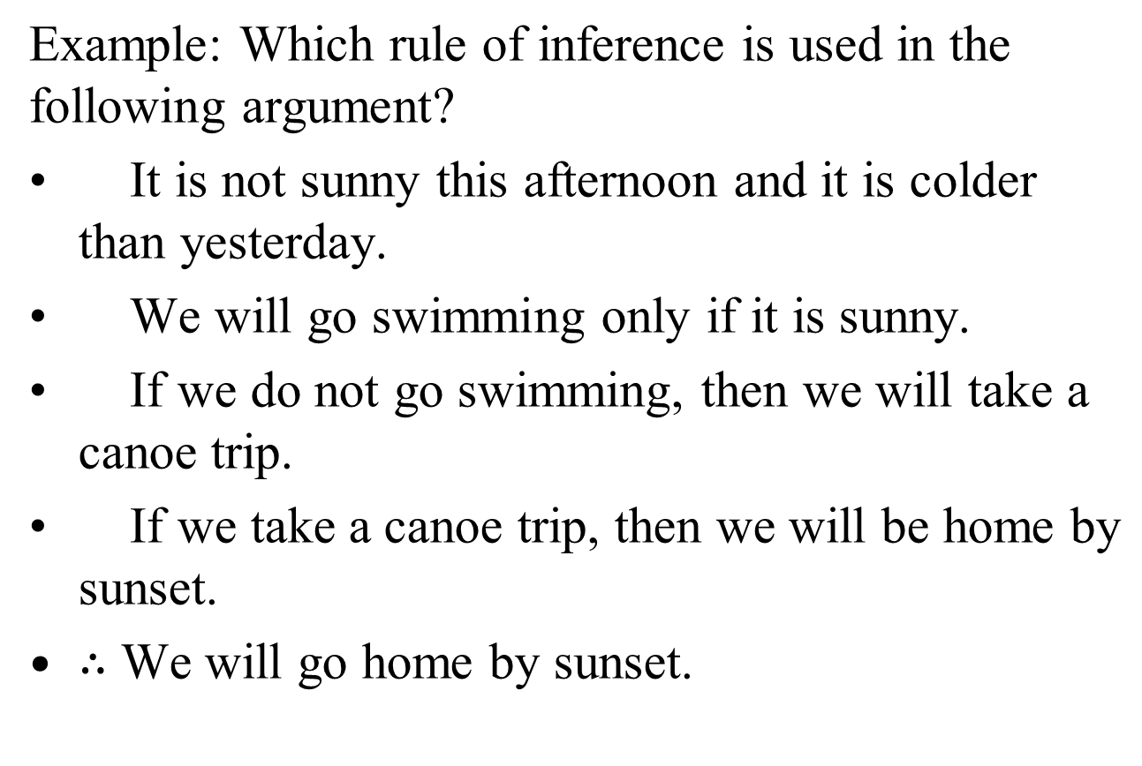

Slide 31
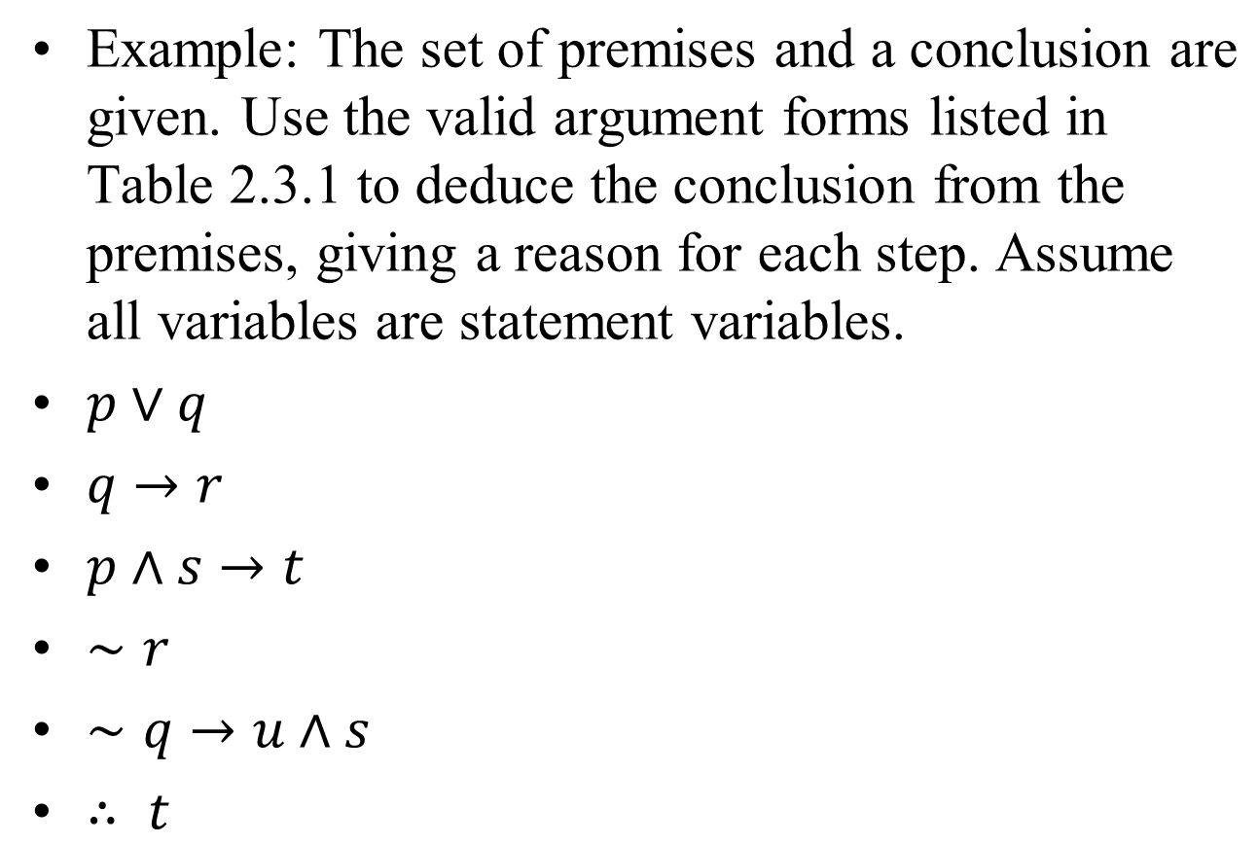

Slide 32
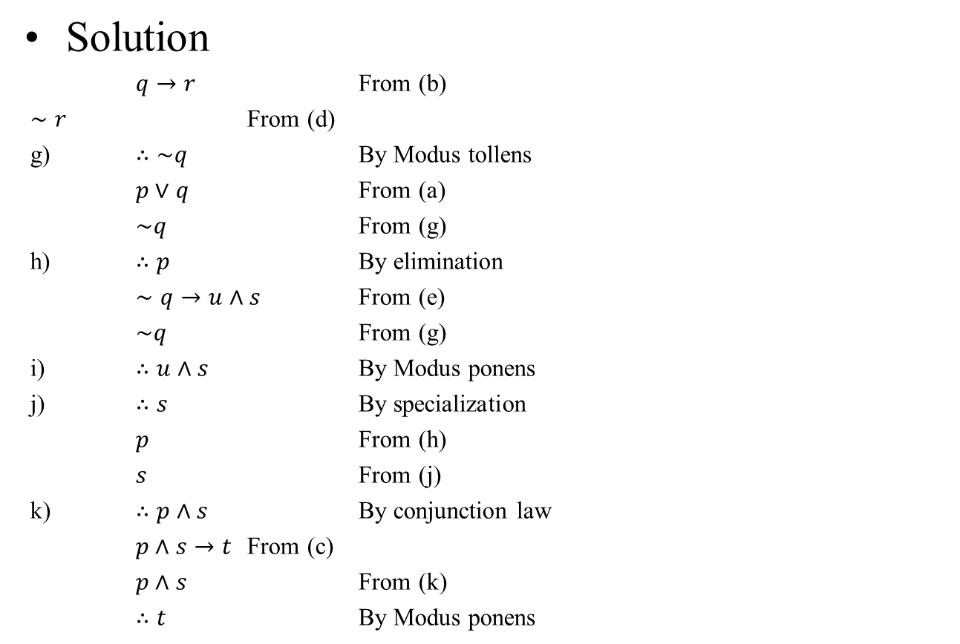
Solution

Slide 33
Example: A More Complex Deduction
You are about to leave for school in the morning and discover that you don’t have your glasses. You know the following statements are true:
  If I was reading the newspaper in the kitchen, then my glasses are on the kitchen table.
  If my glasses are on the kitchen table, then I saw them at breakfast.
  I did not see my glasses at breakfast.
  I was reading the newspaper in the living room or I was reading the newspaper in the kitchen.
  If I was reading the newspaper in the living room then my glasses are on the coffee table.
  Where are the glasses?

Slide 34
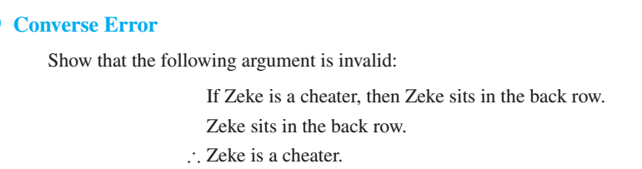
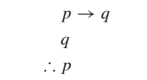
Fallacies
A fallacy is an error in reasoning that results in an invalid argument.

Slide 35
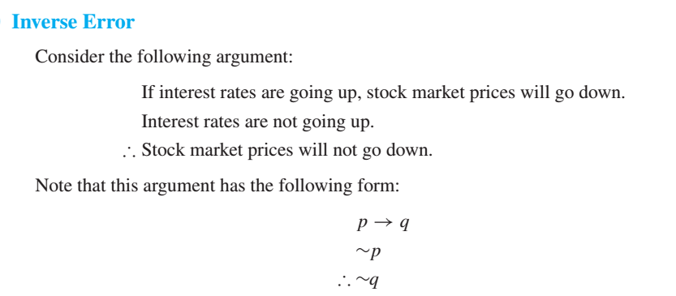

Slide 36

